Slide 1
Advanced SQL
Window Functions

Slide 2
Why Window Function
Powerful concept – important skills to use & be able to identify when to use them.
Allows to compare one row to another without any joins
Can do simple things like create a running total
& Can also do tricky things like determine whether one row is greater than previous row & classify it based on your findings.

Slide 3
Window Function – Introduction
A window function performs a calculation across a set of table rows that are somehow related to the current row.
Notes:
https://www.postgresql.org/docs/9.1/tutorial-window.html

Slide 4
Window Function vs Aggregate Function
The calculations made by window function is comparable to the type of calculation that can be done with an aggregate function.
But unlike regular aggregate functions, use of a window function does not cause rows to become grouped into a single output row — the rows retain their separate identities.
Behind the scenes, the window function is able to access more than just the current row of the query result.
We cannot use window functions & aggregate functions both in the same query.
More- We cannot include window function in a group by clause.

Slide 5
Window Function – Over & Partition By
OVER and PARTITION BY. These are key to window functions.
Not every function use PARTITION BY, we can also use ORDER BY or no statement at all depending upon the query.
A window function call always contain an OVER clause.
OVER clause determines exactly how the rows of the query are split up for processing by window function.
The partition by list within OVER specifies dividing the rows into groups, or partitions, that share the same values of the PARTITION BY expression.
For each row, the window function is computed across the rows that fall into the same partition as the current row.

Slide 6
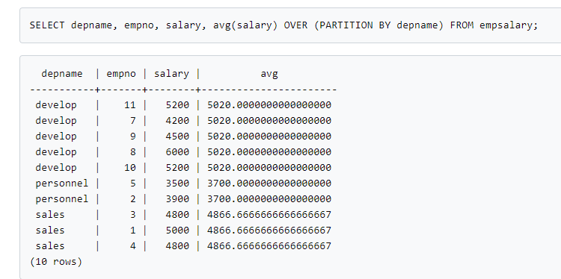
Window Function Example
The first three output columns come directly from the table empsalary.
There is one output row for each row in the table.
The fourth column represents an average taken across all the table rows that have the same depname.
This is same as the regular avg aggregate but the over clause makes it to be treated as a window function & computed across an appropriate set of rows.

Slide 7
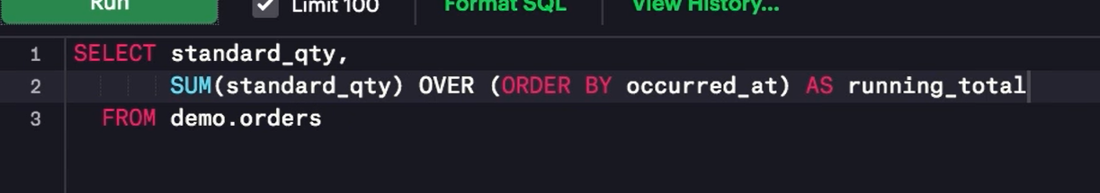
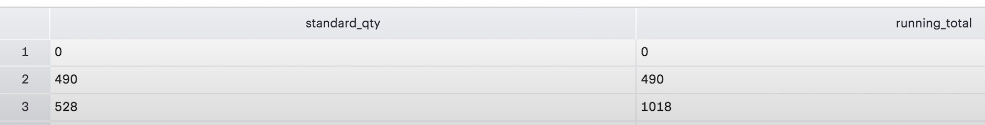
Window Function – Running Total – Daily
How much paper parch & posey have sold today ?
Adding over designates it is a window function.
“take the sum of standard quantity across all rows leading up to a given row in order by occurred at”
Here the window function is applied over entire dataset.

Slide 8
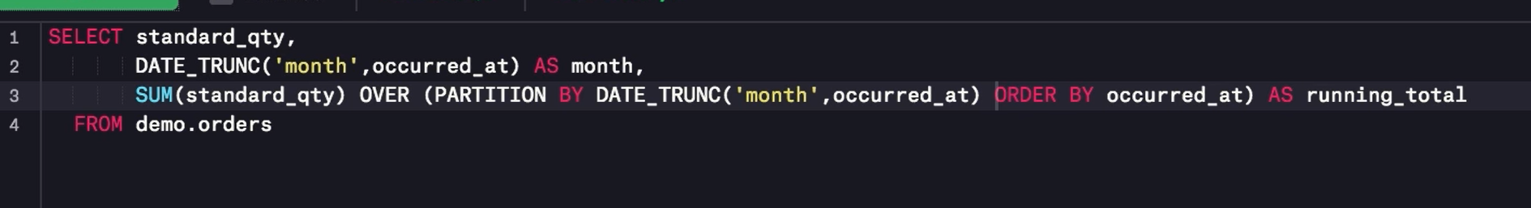
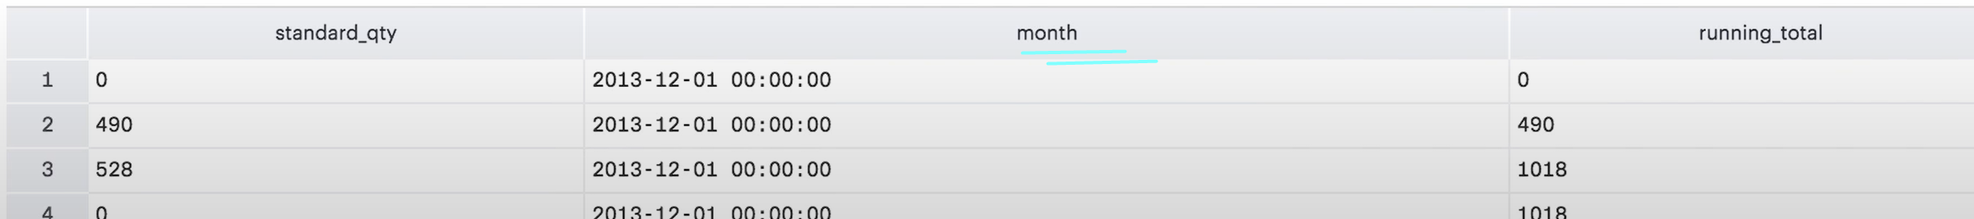
Window Function – Running Total – Partition By
To narrow the window from the entire dataset to the individual groups within a dataset we use partition by function.
This query now groups & orders by the month in which the transaction occurred.
Within each month we are ordering by the occurred at column
Running total here sums across the current row & all prevous rows of std qty.

Slide 9
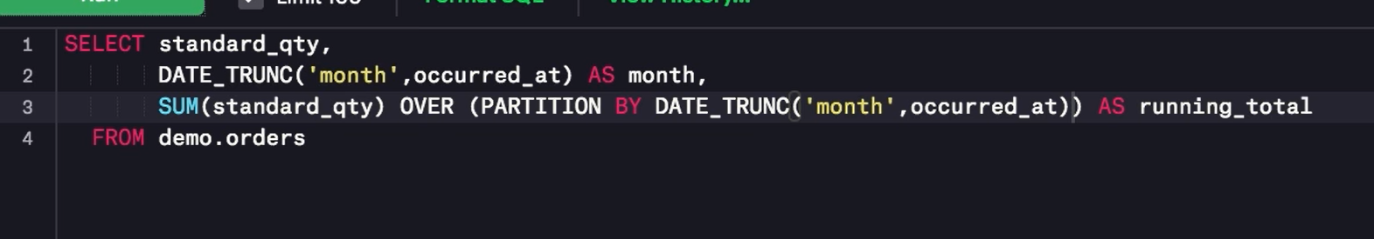
Running the same query without order by
Order by while ordering works the same as normal order by however it treats each partition separate.
Without order by each value will be a sum of all std qty in its respective month.

Slide 10
Important
Order & partition define what's referred to as the window.
The window is the ordered subset of the data over which all these calculations are made.

Slide 11
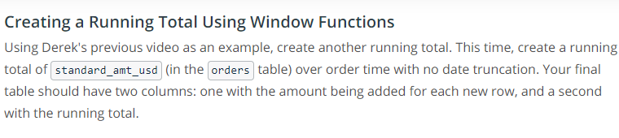
Window Function – Quiz 1

Slide 12
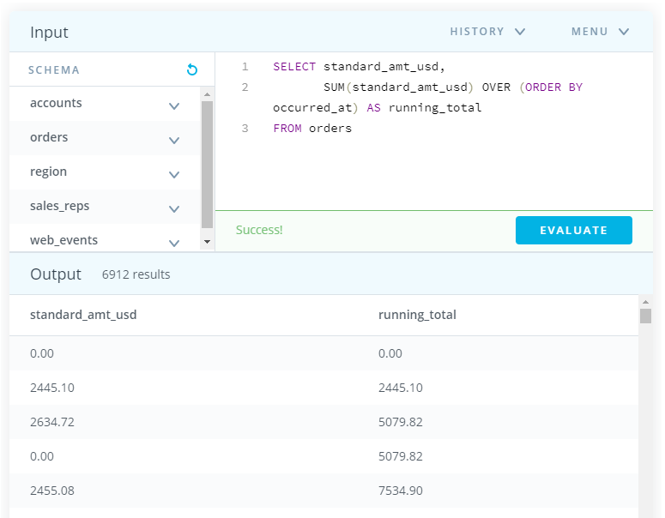
Quiz Solution
Here we have not used any partition by so the window is whole dataset ?

Slide 13
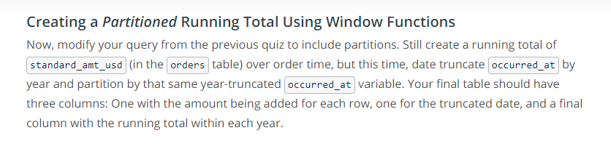
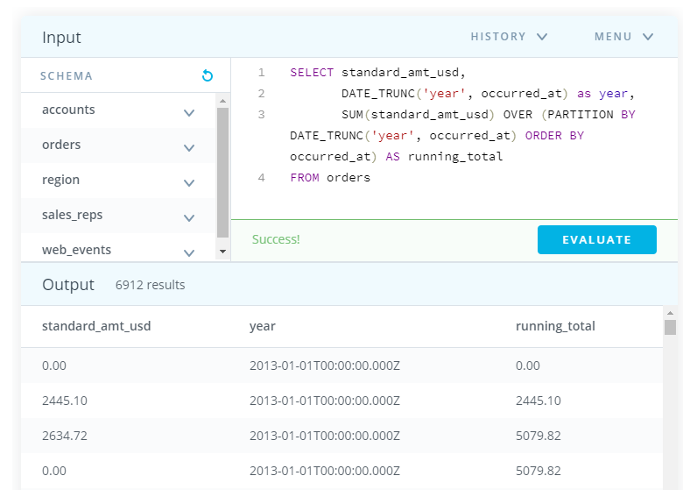
Quiz 2 : Creating a Partitioned Running Total Using Window Functions

Slide 14
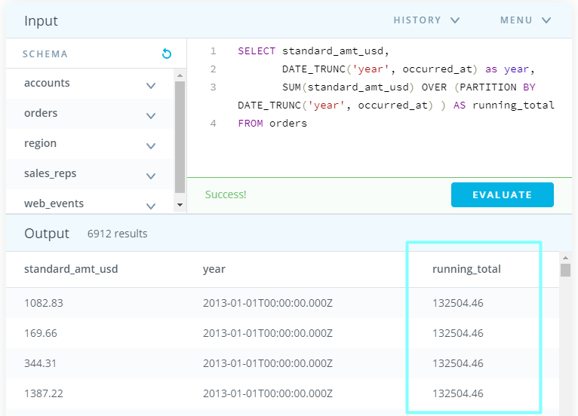
Effect of removing order by
Notes:
Order by & partition creates the window. Here though we have created yearly partition but if we don’t use order by than it will give one sum for the whole year.

Slide 15
Read Stack overflow examples on this link
https://stackoverflow.com/questions/561836/oracle-partition-by-keyword

Slide 16
ROW Number
Displays the number of a given row within a window we define.
Starts at 1 & number the rows according to the order by part of the window statement.
Does not require to specify a variable within parenthesis.

Slide 17
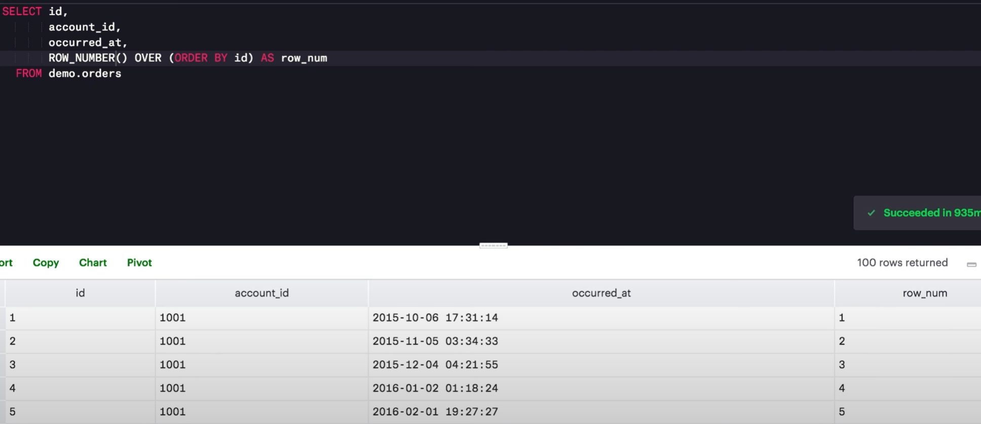
ROW NUMBER – Simple Example
Ordering by the id field therefore here the row number will be the same as the id field.

Slide 18
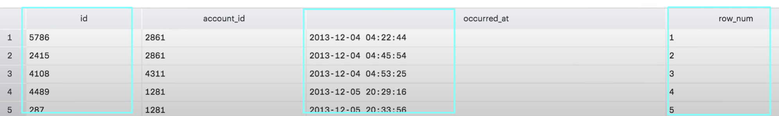
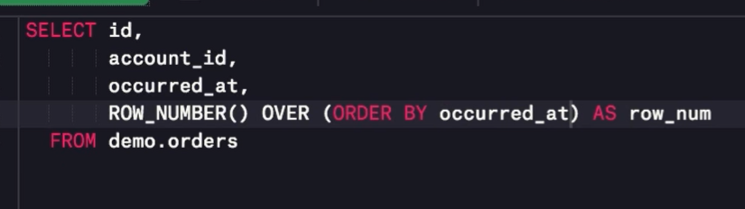
Row Number – Simple example 2
Here, we are using occurred at in the order by clause.
Therefore, here the row num is depending upon the occurred at column hence it is different than the id.

Slide 19
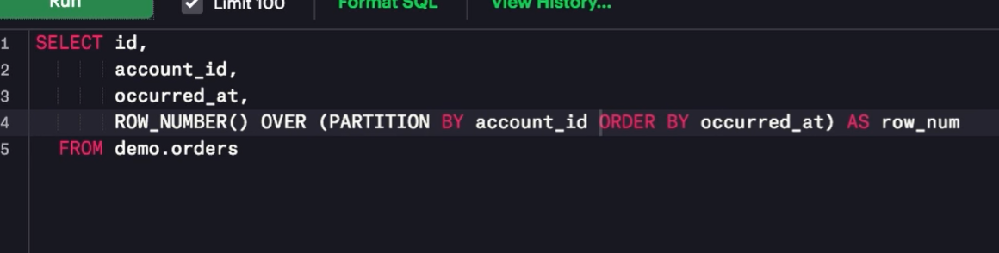
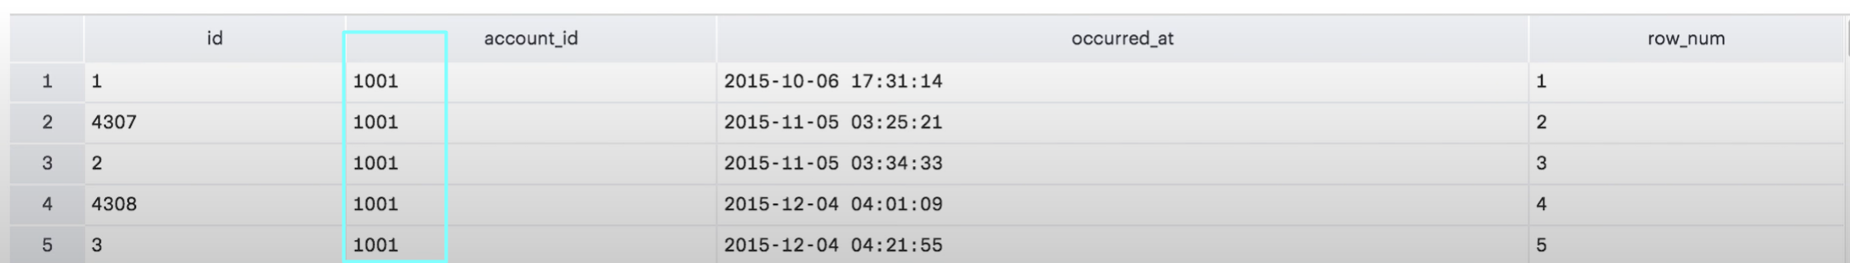
Row Number & Partition By Clause
Here since we have partitioned by the account id.
In each account id, we are getting the row number with respect to occuredt at .
So the row number 1 shows the first order for this account.

Slide 20
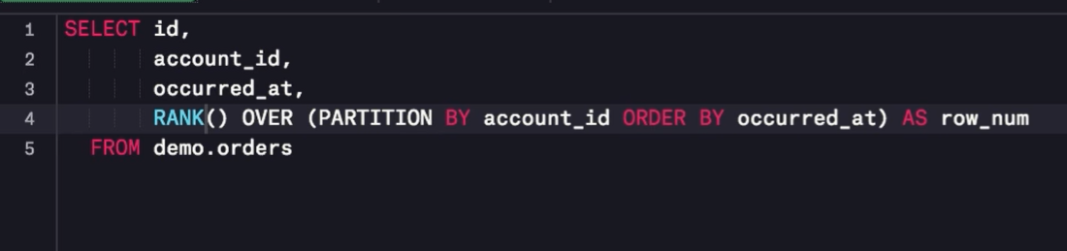
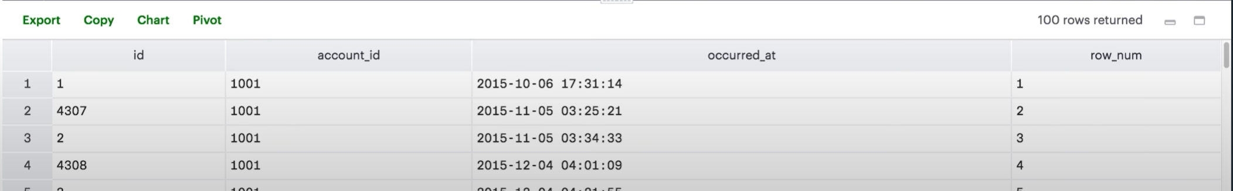
Rank
Works Similar to row number.
If two rows have the same value for the order by column which is occurred at here than they both will get the same rank.
Where as row number assigns different values.

Slide 21
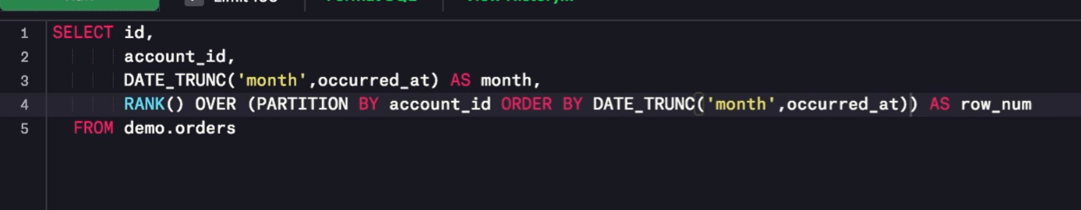
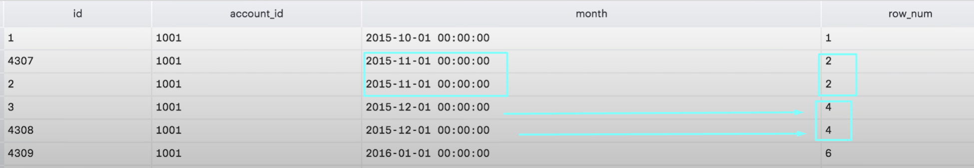
Rank VS Row With example
To illustrate the fact that if the order by column value is same than rank will be the same for the two rows but they will have different values for the row number.
Here entries with the same month have the same rank.
Rank column than skip some values as well.

Slide 22
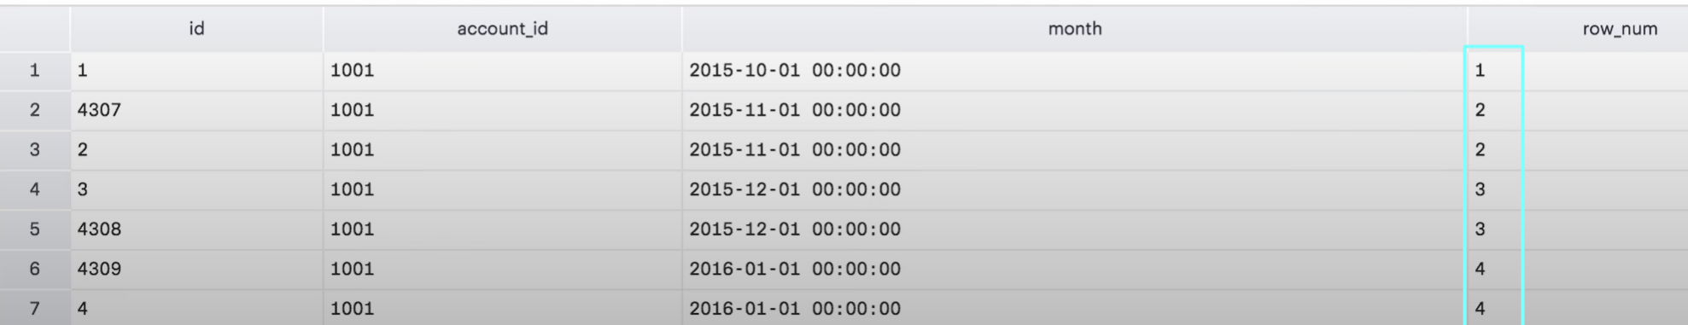
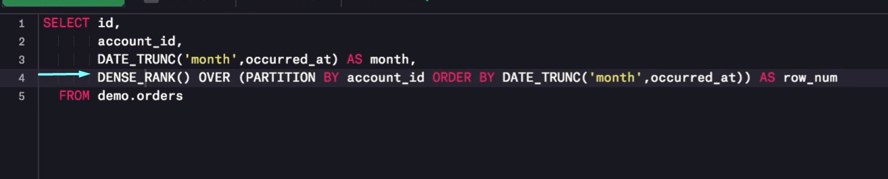
Dense Rank
Does not skip values after assigning several rows the same rank.

Slide 23
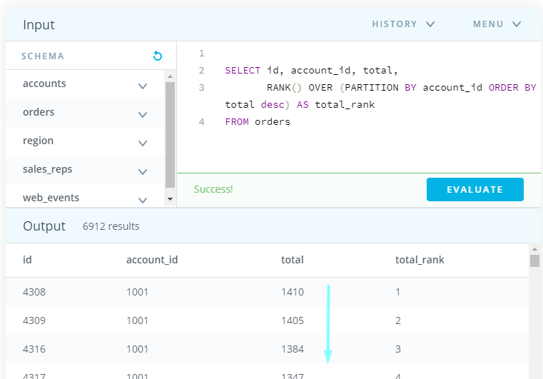
Quiz Row Number & Rank
SELECT id,account_id,total,
RANK() OVER (PARTITION BY account_id ORDER BY total DESC) AS total_rank
FROM orders

Slide 24
Aggregates in Window Function
While using window functions we can apply same aggregate functions that we do normally.
SUM
Count
AVG
Min
Max

Slide 25
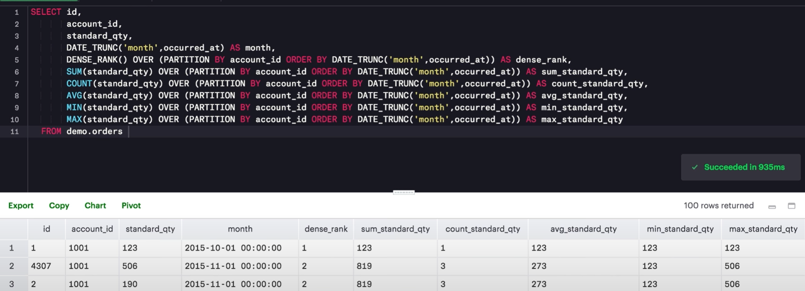
Aggregates in Window Function – Example
Sum is creating a running total. For the ist row the sum is 123 but for the 2nd & third row the sum is 819 for both.
The reason is that we are ordering by month & this creates the same window for both of these entries hence the running sum for these entries will be same.
Row 2 & 3 have the same month they are grouped together.

Slide 26
Aggregates in Window Function – Example Continued
Row 2 & 3 are the same for rank & dense rank as well. Since they belong to the same month hence considered one group.
Similarly count is the running count, hence it will be the same for the group.
Similar for avg. which is running sum / running count.
The main idea is that these aggregations are based on the partition.
Min shows the lowest value up to that point in the window for example 123 is the lowest value until 85 is found. In the next window it will show the minimum for that window.
MAX always show the max value up to that point in the given window.

Slide 27
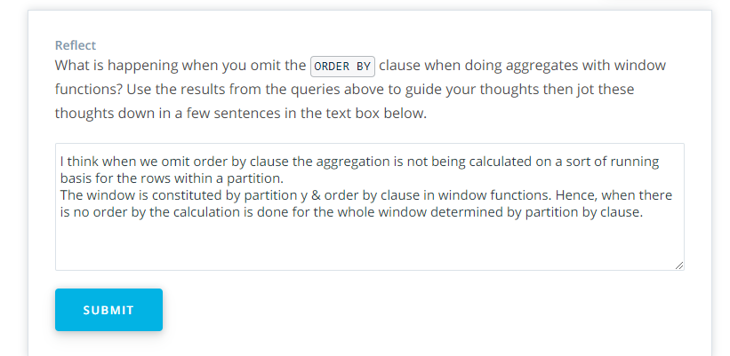
Quiz Aggregates in Window Functions with and without ORDER BY
If we don’t include the order by it than the whole group will have the same value.

Slide 28
Quiz Udacity Explanation
The order by clause is one of two clauses integral to window function.
ORDER & PARTITION define what is referred as a window which is the ordered subset of data over which calculations are made.
If we remove the order by clause, that just leaves an un-ordered partition.
In our query case, when we removed order by each column value is simply an aggregation of all standard_qty in its respective account_id since account_id is what we are using for partition.

Slide 29
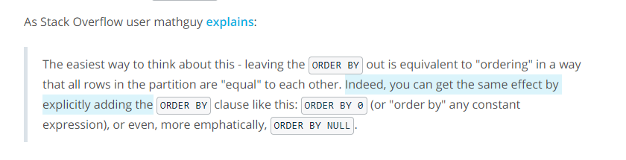
Stack Overflow Explanation
The easiest way to think about this - leaving the ORDER BY out is equivalent to "ordering" in a way that all rows in the partition are "equal" to each other.
Notes:
https://stackoverflow.com/questions/41364665/analytic-count-over-partition-with-and-without-order-by-clause

Slide 30
Aliases for Multiple Window Functions
Helpful when we are creating multiple window functions within the same query in the same window, we can create aliases.
We define a alias using WINDOW clause, which goes between the where clause & group by clause. Or if you don’t have group by or where than simply put after from.

Slide 31
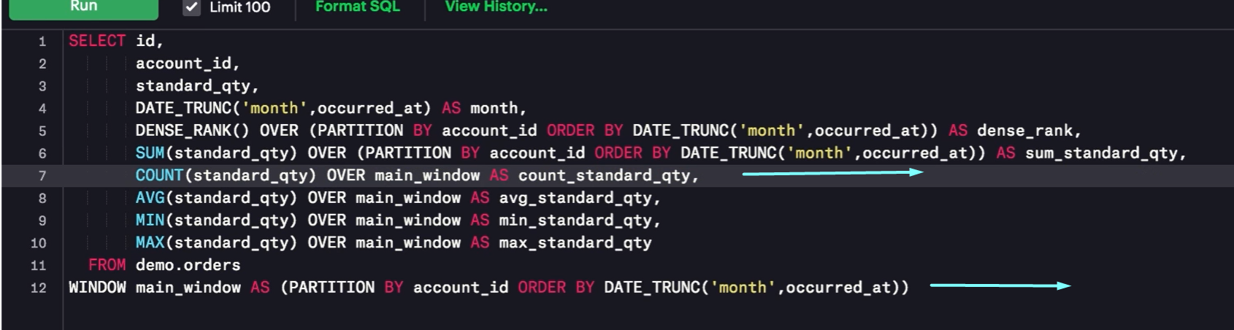
How to use Alias.
We remove the part after over & before as which is basically the logic of the window function we are computing.
We use WINDOW clause with AS & write it after from.
The partition logic is sent below, makes our query easy to read.

Slide 32
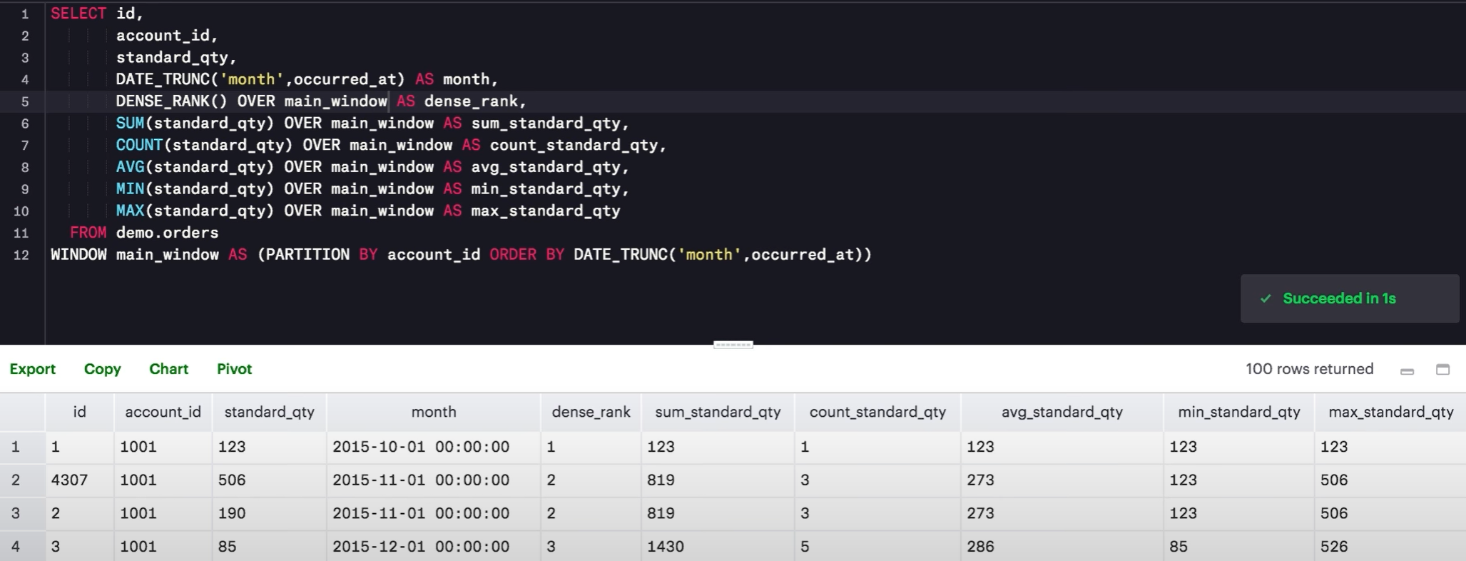
Final version after aliasing
Notes:
Same result but easier to read the query.

Slide 33
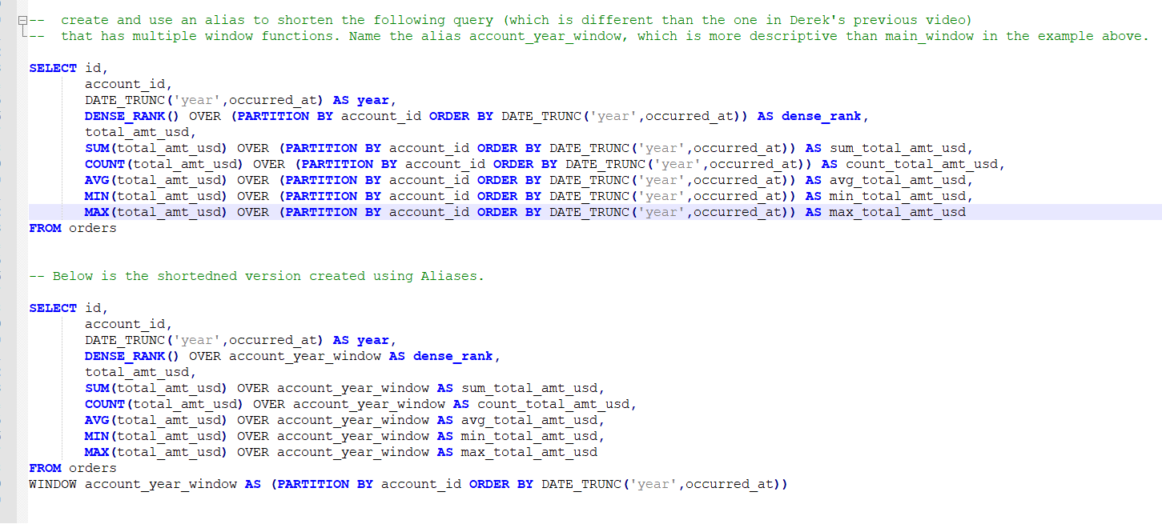
Using Alias – Example

Slide 34
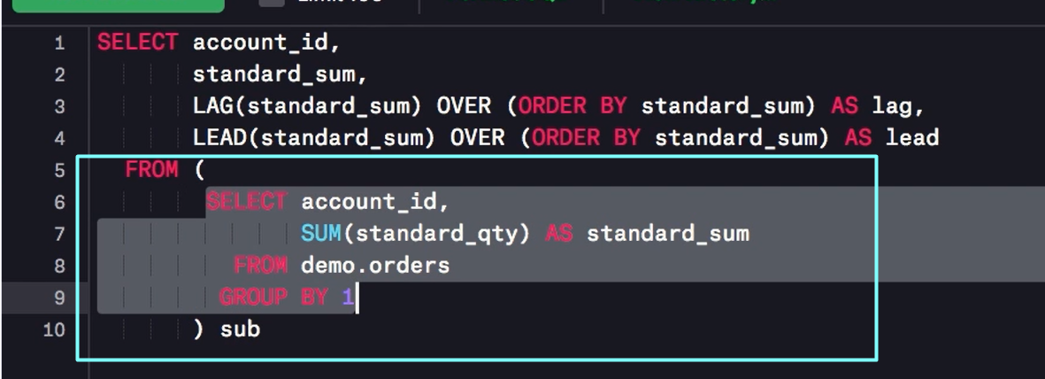
Comparing a Row to Previous Row -1
Useful to compare rows to preceding or following rows, especially if the data is like that it makes sense to compare these rows.
For example, how much standard paper each account has purchased over all times.
This is being computed in the inner query here.

Slide 35
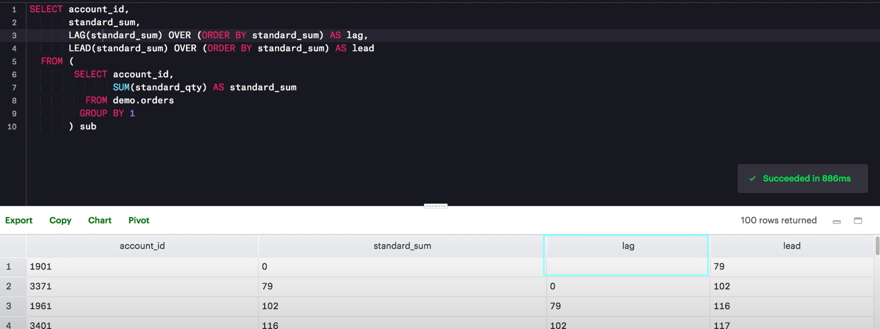
Lag & Lead
Lag & lead are used to create columns that pull values from other rows.
The syntax describes which column to pull from & how many rows away you would like to do the pull.
Lag pulls form the previous rows
Lead pulls from the following rows.
Notes:
1- Lag for the first row is null since there is no previous row to the first row. Lag for the 2nd row is the value of standard sum for the first row.
2- The column which we selected here is standard sum column to find the lag, this is passed as a parameter to LAG.
3- Lead column goes in the opposite direction, this can be specially useful when calculating different between the two rows.
4- We see here that the lead column has 79 for the first row.

Slide 36
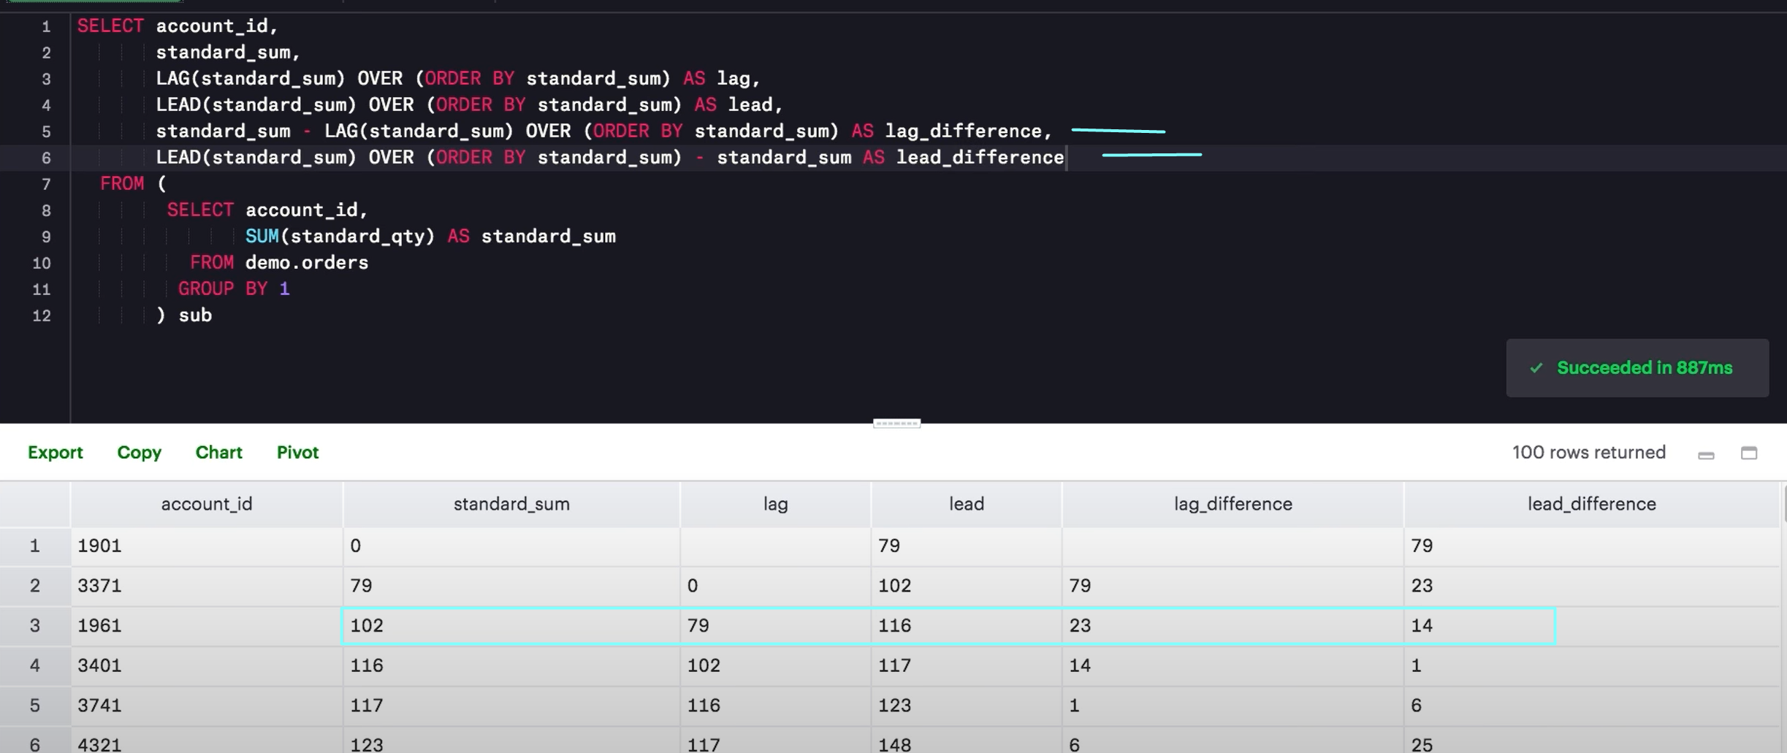
Lag & lead Differences
Notes:
Lag difference is simply subtracting the current row – lag . Here lag is the value of the prior row.

Slide 37
Scenarios for using LAG & LEAD
You can use LAG and LEAD functions whenever you are trying to compare the values in adjacent rows or rows that are offset by a certain number.
Specially in case of time based events.

Slide 38
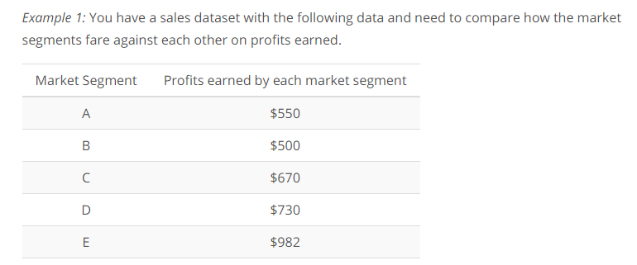
Scenarios for using LAG & LEAD – Example 1

Slide 39
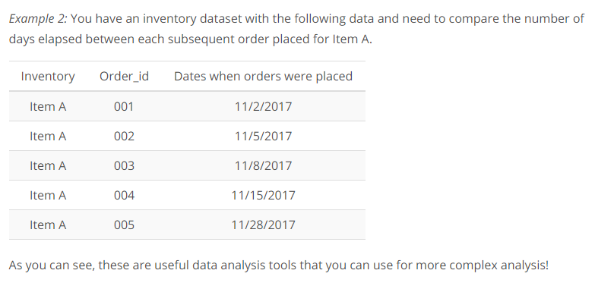
Scenarios for using LAG & LEAD – Example 2

Slide 40
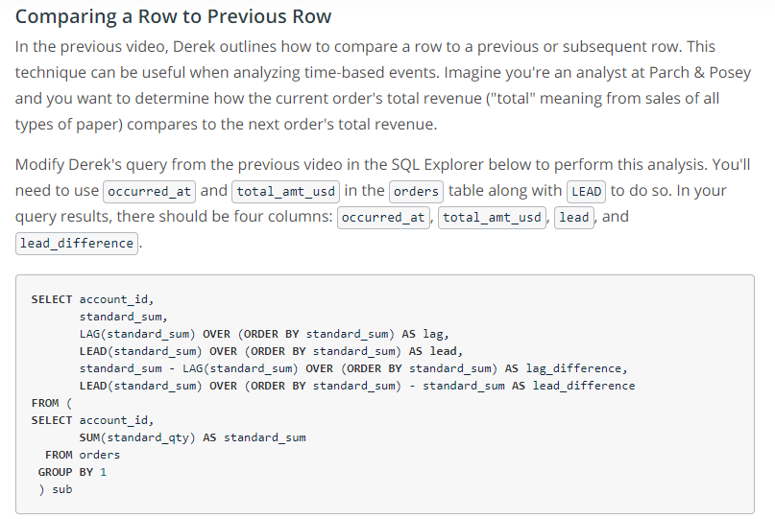
Quiz – Comparing a Row to Previous Row

Slide 41
Percentiles – Ntile window Function
Previously, we were performing analysis of the inventory.
Min, max, avg order sizes.
Best way to understand is to use percentile to see where most order falls to be better prepared.
Notes:
NTILE POSTGRESQL documentation
https://www.postgresql.org/docs/current/functions-window.html

Slide 42
NTILE Window Function – why
You can use window functions to identify what percentile (or quartile, or any other subdivision) a given row falls into using NTILE window function.

Slide 43
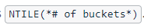
Syntax & Usage
ORDER BY determines which column to use to determine the quartiles (or whatever number of tiles you specify)
The number specified inside the NTILE brackets determine the number of parts into which we will divide the window.
100 means percentile, 5 means quintiles, 4 means quartiles.
Order by than determines which column to use for dividing the window into percentiles, quartiles or whatever.

Slide 44
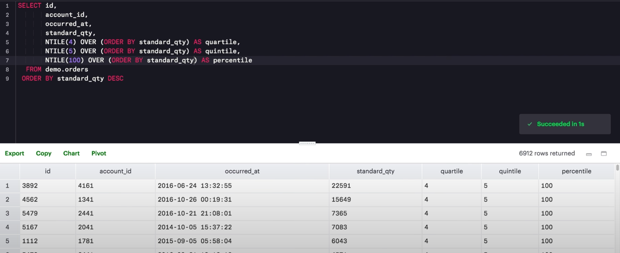
NTILE Example
Notes:
Here in this example we are using standard_qty for developing the quartiles, quintile s7 percentiles.
For each row, NTILE function will look at the value of standard_qty, compare its value to all the values of standard_qty in the window & than print the division (quartile, quintile or percentile) in which the row falls.
For example, the row with 3892 falls in the quartile 4, percentile 100
The highest value will fall in the 4th quartile.
A standard qty value of 0 may fal in the first quartile

Slide 45
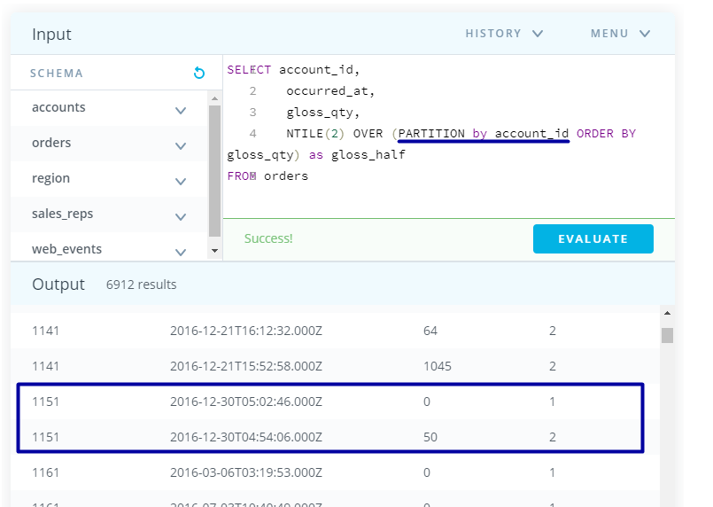
Ntiles & Partition by
We can also use partitions with percentiles to determine the percentile of a specific subset of all rows.
When we are using partition by it with NTILEs, it means when we are calculating the divisions we are doing that for that specific window & not for whole dataset.
Here, 1151 account has only 2 values 0 & 50 therefore the values above 25 falls in the 2nd half & values below 25 falls in the lower half.

Slide 46
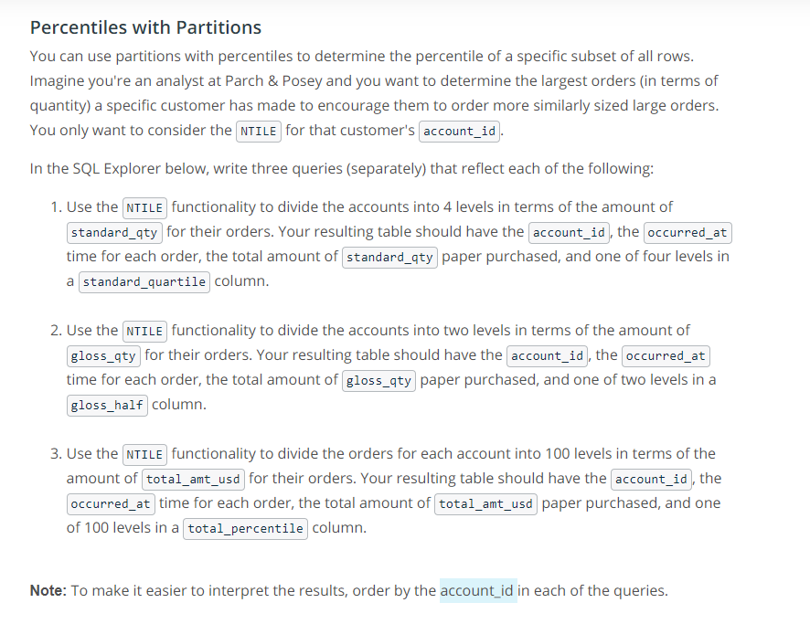
Quiz

Slide 47
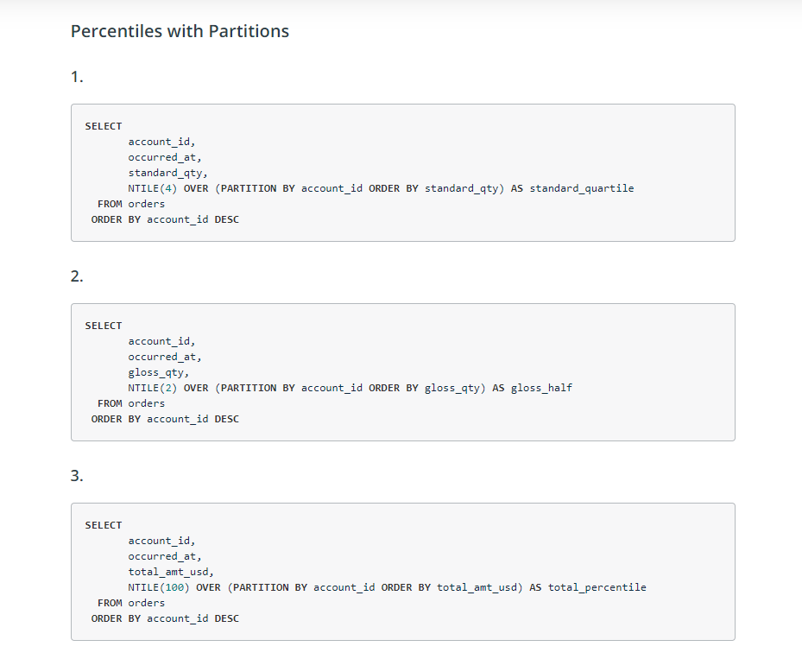
Quiz Solution

Slide 48
Summary
Creating windows
Advanced analysis
Do practice

